Slide 1

ONLINE SURVEY SYSTEM
Yash Umredkar 20104012
Pratham Pise 20104069
Disha Phatta 20104029
Sanskruti Rawal 20104020
Project Guide
Ms. Rucha Kulkarni

Slide 2
Contents
Introduction
Objectives
Scope
Features / Functionality
Project Outcomes
Technology Stack
Block Diagram if applicable

Slide 3
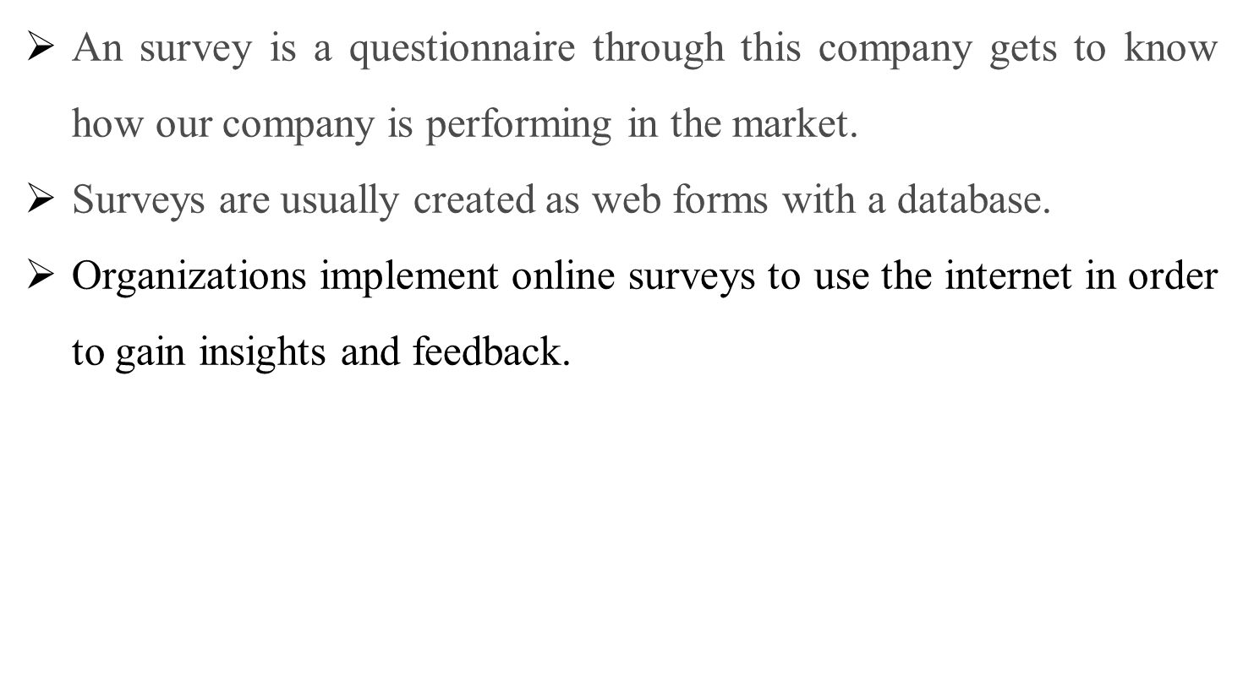
1. Introduction

Slide 4
2. Objectives
To study the customer satisfaction level for car models of the different companies.
To analyse complaints of customers towards cars and services.
To find out the customer interest for the company’s models.

Slide 5
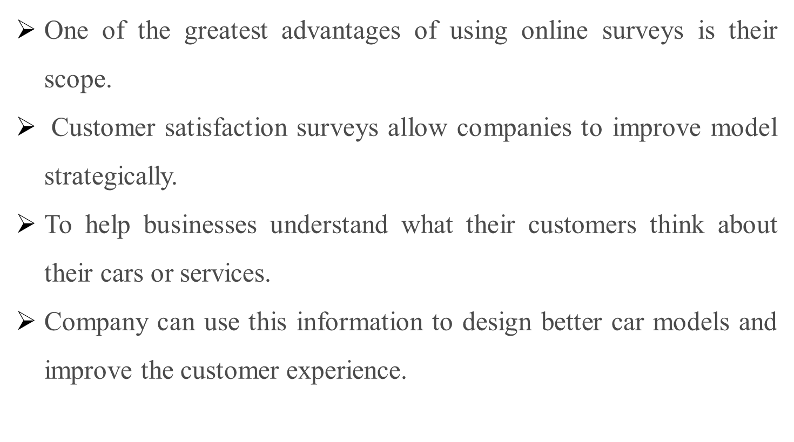
3. Scope

Slide 6
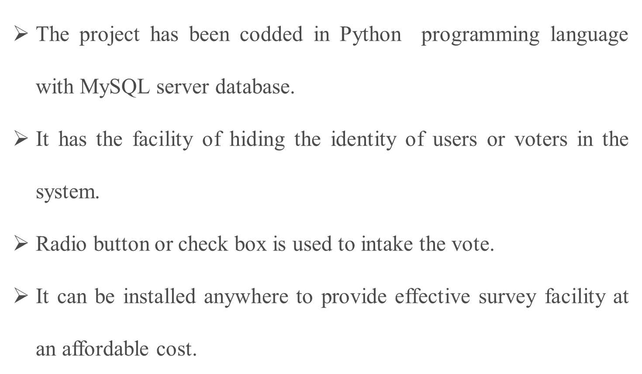
4. Feature /Functionality

Slide 7
5. Outcome of Project
Customer can login, and admin or host can create questionnaire of any car companies for customers.
It can identify opportunities for car model innovation.
It can ensure the quality improvement efforts are correctly focused on issues that are most important to a customer.

Slide 8
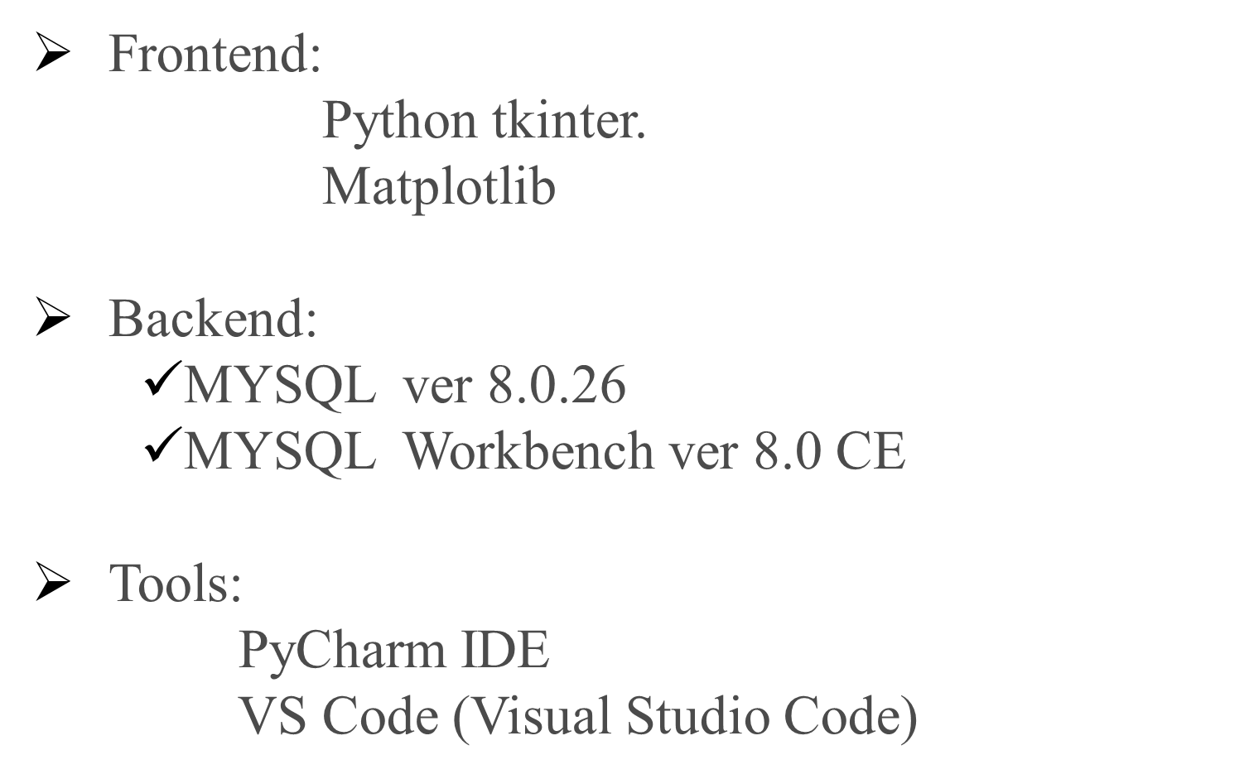

6. Technology Stack

Slide 9







7. Block Diagram
User
Management
Survey Analysis
Survey ID
Management
Survey
Management
System
Register
Management
Review Collection
User Response
Management

Slide 10
Thank You...!!

